Slide 1
Software Engineering Unit-II
Prepared by: Neha Tripathi

Slide 2
Analysis Tools
Data Flow Diagrams(DFDs)
Data Dictionary
Decision Tree
Decision Table
Structured Chart
etc.

Slide 3
Design Approaches and Types
Function Oriented approach
Object Oriented approach
Types of Design: System Design Structured Analysis(SA)
Detailed design Structured Design(SD)
Structured Analysis Tools: DFDs, Data dictionary, Decision Tree, Decision Table, ERDs etc.
Structured Design Tools: Structured chart/Module dependency Graph

Slide 4
Structured Analysis/ Structured design (SA/SD)
SA/SD methodology involves carrying out two distinct activities:
-Structured analysis (SA)
-Structured design (SD)
During structured analysis, the SRS document is transformed into a data flow diagram (DFD) model.
During structured design, the DFD model is transformed into a structure chart.

Slide 5
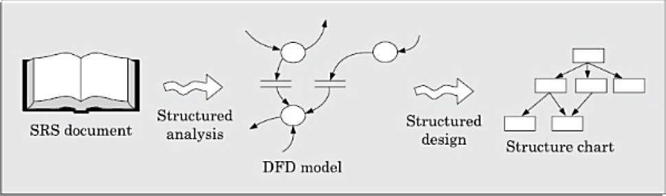

Slide 6
Structured Analysis
Structured analysis is used to carry out the top-down decomposition of a set of high-level functions depicted in the problem description and to represent them graphically. During structured analysis, functional decomposition of the system is achieved. That is, each function that the system performs is analyzed and hierarchically decomposed into more detailed functions.
Structured analysis technique is based on the following essential underlying principles:
• Top-down decomposition approach.
• Divide and conquer principle. Each function is decomposed independently.
• Graphical representation of the analysis results using Data Flow Diagrams(DFDs).

Slide 7
Data Flow Diagram (DFD)
https://www.youtube.com/watch?v=KkxcehpkQ2M&t=1205s
The DFD (also known as a bubble chart) is a hierarchical graphical model of a system that shows the different processing activities or functions that the system performs and the data interchange among these functions.
Each function is considered as a processing station (or process) that consumes some input data and produces some output data.
The system is represented in terms of the input data to the system, various processing carried out on these data, and the output data generated by the system.
A DFD model uses a very limited number of primitive symbols to represent the functions performed by a system and the data flow among these functions.

Slide 8
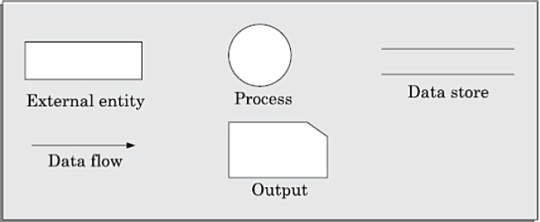
Primitive symbols used for constructing DFDs

Slide 9
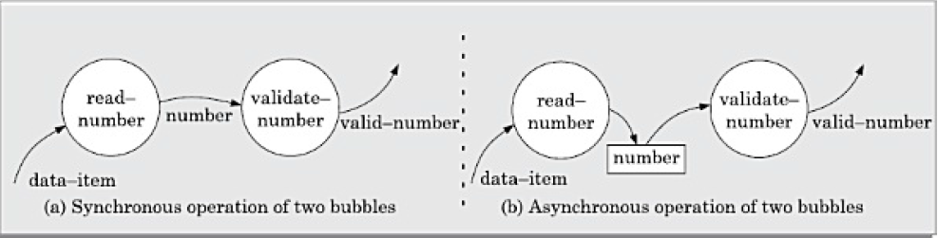
Important concepts associated with constructing DFD models
Synchronous and Asynchronous DFD

Slide 10
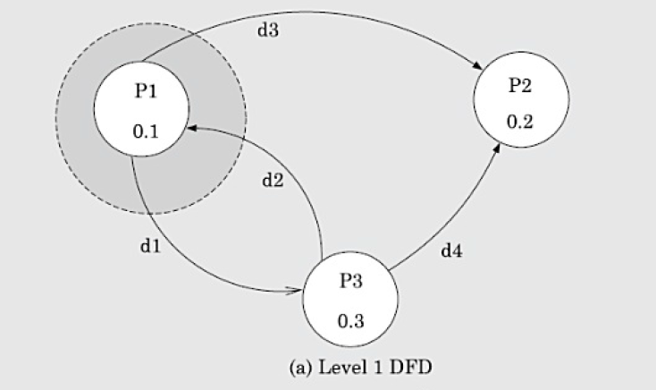
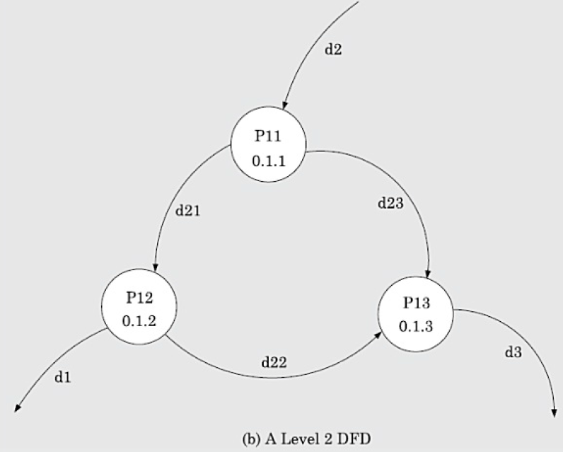
Balancing DFDs: The data that flow into or out of a bubble must match the data flow at the next level of DFD. This is known as balancing a DFD.

Slide 11
Numbering of bubbles
It is necessary to number the different bubbles occurring in the DFD.
These numbers help in uniquely identifying any bubble in the DFD from its bubble number.
The bubble at the context level is usually assigned the number 0 to indicate that it is the 0 level DFD.
Bubbles at level 1 are numbered, 0.1, 0.2, 0.3, etc. When a bubble numbered x is decomposed, its children bubble are numbered x.1, x.2, x.3, etc.
In this numbering scheme, by looking at the number of a bubble we can unambiguously determine its level, its ancestors, and its successors.

Slide 12
DEVELOPING THE DFD MODEL OF A SYSTEM
A DFD model of a system graphically represents how each input data is transformed to its corresponding output data through a hierarchy of DFDs.
The DFD model of a problem consists of many DFDs and a single data dictionary.
The DFD model of a system i s constructed by using a hierarchy of DFDs called as Levels.

Slide 13
Levels of DFD
0-Level/Context DFD:
The context diagram is the most abstract (highest level) data flow representation of a system. It represents the entire system as a single bubble. It establishes the context in which the system operates; that is, who are the users, what data do they input to the system, and what data they received by the system.
1-Level DFD:
The level 1 DFD usually contains three to seven bubbles. That is, the system is represented as performing three to seven important functions. To develop the level 1 DFD, examine the high-level functional requirements in the SRS document.
2-Level/Detailed DFD:
The level 2 DFD is made for those bubbles in level 1 DFD whose details /decomposition is possible.

Slide 14
Rules for constructing DFD systematically in Levels:
1. Construction of context diagram: Examine the SRS document to determine:
• Different high-level functions that the system needs to perform.
• Data input to every high-level function.
• Data output from every high-level function.
• Interactions (data flow) among the identified high-level functions.
Represent these aspects of the high-level functions in a diagrammatic form. This would form the top-level data flow diagram (DFD), usually called the DFD 0.
2.Construction of level 1 diagram:
Examine the high-level functions described in the SRS document.
If there are three to seven high-level requirements in the SRS document, then represent each of the high-level function in the form of a bubble.
If there are more than seven bubbles, then some of them have to be combined.
If there are less than three bubbles, then some of these have to be split.

Slide 15
3. Construction of lower-level diagrams: Decompose each high-level function into its constituent sub-functions through the following set of activities:
• Identify the different sub-functions of the high-level function.
• Identify the data input to each of these sub-functions.
• Identify the data output from each of these sub-functions.
• Identify the interactions (data flow) among these sub-functions.
Represent these aspects in a diagrammatic form using a DFD. Recursively repeat Step 3 for each sub-function until a sub-function can be represented by using a simple algorithm.

Slide 16
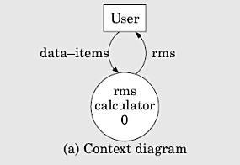
Example : (RMS Calculating Software)
A software system called RMS calculating software would read three integral numbers from the user in the range of –1000 and +1000 and would determine the root mean square (RMS)of the three input numbers and display it.
0-Level/Context DFD:

Slide 17
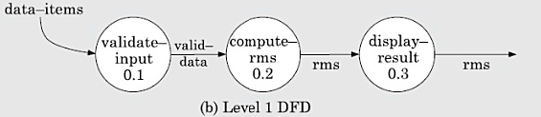
1-Level DFD:

Slide 18
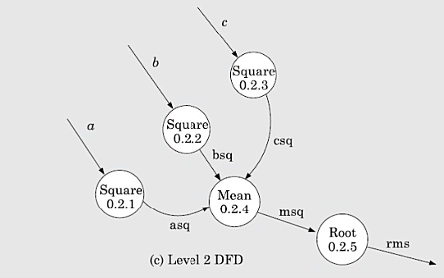
2-Level/Detailed DFD

Slide 19
Shortcomings of the DFD model
Imprecise DFDs leave ample scope to be imprecise.
Not-well defined control aspects are not defined by a DFD.
Decomposition: The method of carrying out decomposition to arrive at the successive levels and the ultimate level to which decomposition is carried out are highly subjective and depend on the choice and judgment of the analyst.
Improper data flow diagram: T he da ta flow diagramming technique does not provide any specific guidance as to how exactly to decompose a given function into its sub-functions and we have to use subjective judgment to carry out decomposition.

Slide 20
STRUCTURED DESIGN
The aim of structured design is to transform the results of the structured analysis (that is, the DFD model) into a structure chart.
A structure chart represents the software architecture.
The various modules making up the system, the module dependency (i.e. which module calls which other modules), and the parameters that are passed among the different modules.
The structure chart representation can be easily implemented using some programming language.

Slide 21
Notations Used:
Rectangular boxes: A rectangular box represents a module.
Module invocation arrows: An arrow connecting two modules implies that during program execution control is passed from one module to the other in the direction of the connecting arrow.
Data flow arrows: These are small arrows appearing alongside the module invocation arrows. The data flow arrows are annotated with the corresponding data name.
Library modules: A library module is usually represented by a rectangle with double edges. Libraries comprise the frequently called modules.
Selection: The diamond symbol represents the fact that one module of several modules connected with the diamond symbol i s invoked depending on the outcome of the condition attached with the diamond symbol.
Repetition: A loop around the control flow arrows denotes that the respective modules are invoked repeatedly.

Slide 22
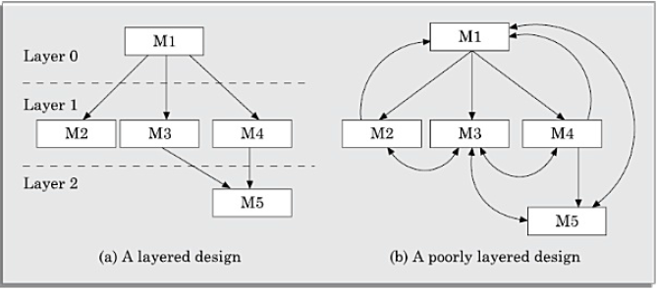
Example of Properly and poorly Layered design

Slide 23
Transformation of a DFD Model into Structured Chart
Structured design provides two strategies to guide transformation of a DFD into a structure chart:
-Transform analysis
-Transaction analysis
If all the data flow into the diagram are processed in similar ways (i.e. if all the input data flow arrows are incident on the same bubble in the DFD) the transform analysis is applicable.
Otherwise, transaction analysis is applicable.
Normally, transform analysis is applicable only to very simple processing.
Note: one would start with the level 1 DFD, transform it into module representation using either the transform or transaction analysis and then proceed toward the lower level DFDs.

Slide 24
Transform analysis
Transform analysis identifies the primary functional components (modules) and the input and output data for these components. The first step in transform analysis is to divide the DFD into three types of parts:
- Input.
- Processing.
- Output.
The input portion in the DFD includes processes that transform input data from physical (e.g, character from terminal) to logical form (e.g. internal tables, lists, etc.). Each input portion is called an afferent branch.
The output portion of a DFD transforms output data from logical form to physical form. Each output portion is called an efferent branch.
The remaining portion of a DFD is called central transform.
In the next step of transform analysis, the structure chart is derived by drawing one functional component each for the central transform, the afferent and efferent branches. These are drawn below a root module, which would invoke these modules.

Slide 25
The first level o f structure chart is produced by representing each input and output unit as a box and each central transform as a single box.
In the third step of transform analysis, the structure chart is refined by adding sub-functions required by each of the high-level functional components.
Many levels of functional components may be added. This process of breaking functional components into subcomponents is called factoring.
The factoring process is continued until all bubbles in the DFD are represented in the structure chart.

Slide 26
Example : Draw the structure chart for the RMS software
By observing the level 1 DFD, we can identify validate-input as the afferent branch and write-output as the efferent branch. The remaining (i.e., compute-rms) as the central transform.
By applying the step 2 and step 3 of transform analysis, we get the structure chart

Slide 27
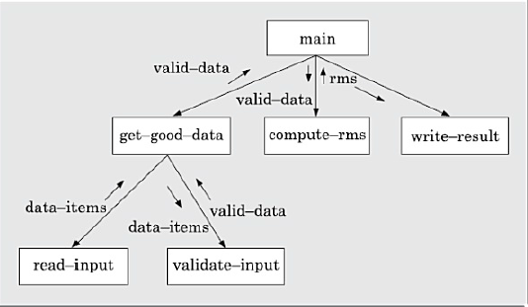

Slide 28
Transaction analysis
As in transform analysis, first all data entering into the DFD need to be identified.
In a transaction-driven system, different data items may pass through different computation paths through the DFD. This is in contrast to a transform centered system where each data item entering the DFD goes through the same processing steps.
Each different way in which input data is processed is a transaction.
A simple way to identify a transaction is the following. Check the input data. The number of bubbles on which the input data to the DFD are incident defines the number of transactions. However, some transactions may not require any input data. These transactions can be identified based on the experience gained from solving a large number of examples.
For each identified transaction, trace the input data to the output. All the traversed bubbles belong to the transaction. These bubbles should be mapped to the same module on the structure chart.
In the structure chart, draw a root module and below this module draw each identified transaction as a module.
Every transaction carries a tag identifying its type. Transaction analysis uses this tag to divide the system into transaction modules and a transaction-center module.

Slide 29
Thank You!

